Slide 1
12강.Actor-Critic: PPO

Slide 2
Contents
Advantage function
Generalized Advantage Estimator (GAE)
Off-policy Policy Gradient
Off-policy Actor-Critic
Trust Region Policy Optimization(TRPO)
Proximal Policy Optimization(PPO)
Code Ex.
PPO continuous action
Code Ex.

Slide 3
Advantage GAE

Slide 4
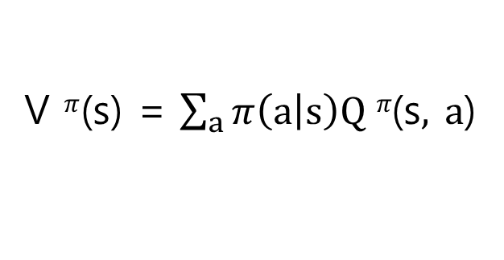
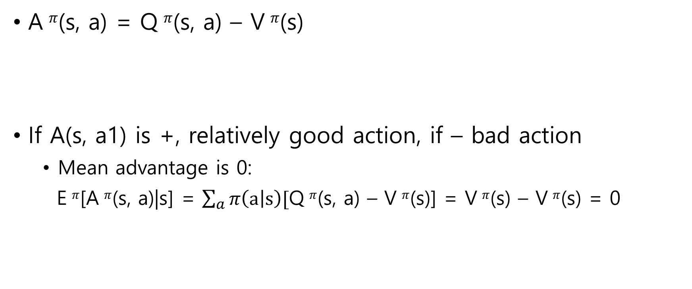
Advantage function
A $π$(s, a) = Q $π$(s, a) – V $π$(s)
If A(s, a1) is +, relatively good action, if – bad action
Mean advantage is 0:
E $π$[A $π$(s, a)|s] = $\sum_{a}{π\left(a | s\right)[}$Q $π$(s, a) – V $π$(s)] = V $π$(s) – V $π$(s) = 0
V $π$(s) = $\sum_{a}{π\left(a | s\right)Q π\text{(}\text{s}, a\text{)}}$

Slide 5
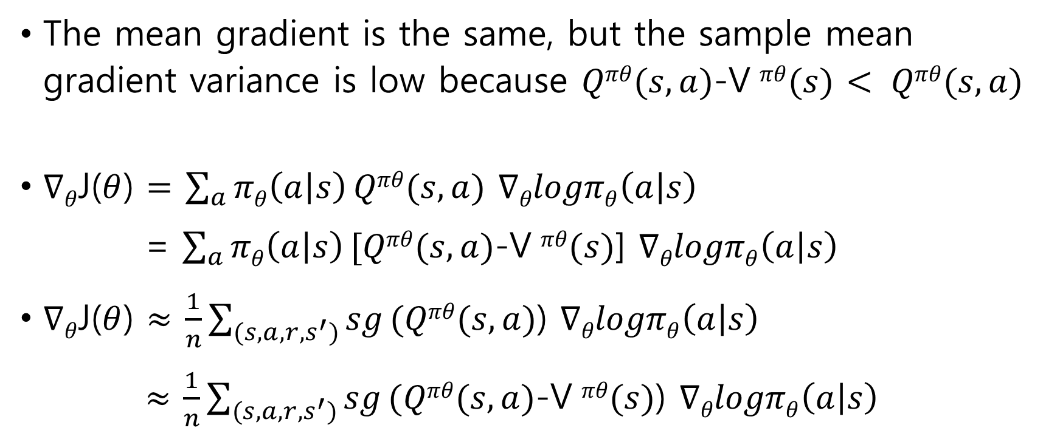
Advantage function
The mean gradient is the same, but the sample mean gradient variance is low because $Qπθ(s,a)$-V $πθ(s)$ $< Qπθ(s,a)$
$∇θ$J($θ$) $=$ $\sum_{a}{πθ\left(a | s\right)}Qπθ(s,a)$ $∇θlogπθ\left(a | s\right)$
= $\sum_{a}{πθ\left(a | s\right)}[Qπθ(s,a)$-V $πθ(s)$] $∇θlogπθ\left(a | s\right)$
$∇θ$J($θ$) $≈$ $\frac{1}{n}\sum_{(s,a,r,s^{′})}{sg}(Qπθ(s,a)$) $∇θlogπθ\left(a | s\right)$
$≈$ $\frac{1}{n}\sum_{(s,a,r,s^{′})}{sg}(Qπθ(s,a)\text{−}\text{V} πθ(s)$) $∇θlogπθ\left(a | s\right)$
High variance
Low variance

Slide 6
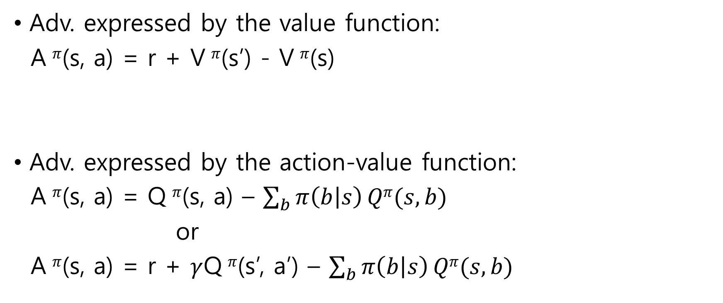
Advantage function
Adv. expressed by the value function:
A $π$(s, a) = r + V $π$(s’) - V $π$(s)
Adv. expressed by the action-value function:
A $π$(s, a) = Q $π$(s, a) – $\sum_{b}{π\left(b | s\right)}Qπ(s,b)$
or
A $π$(s, a) = r + $γ$Q $π$(s’, a’) – $\sum_{b}{π\left(b | s\right)}Qπ(s,b)$
1-step TD error!

Slide 7
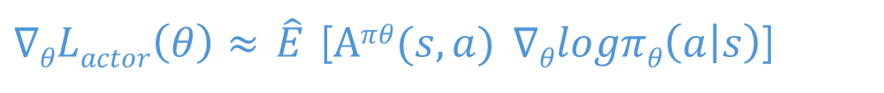
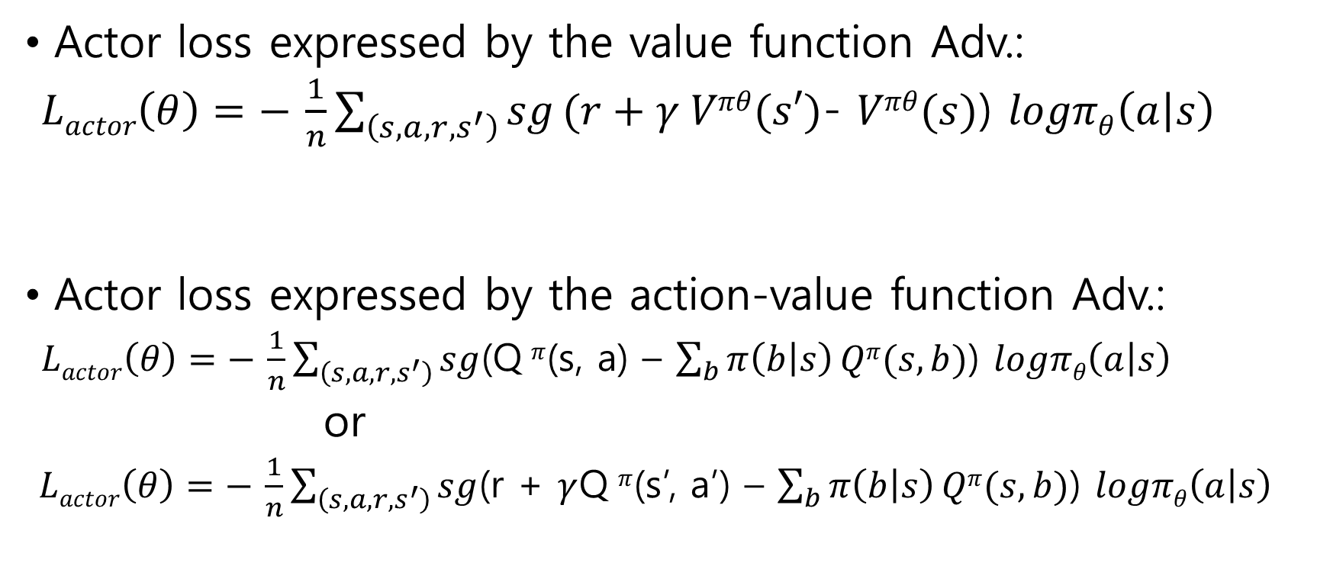
Advantage function
Actor loss expressed by the value function Adv.:
$Lactor\left(θ\right)=− \frac{1}{n}\sum_{\left(s,a,r,s^{′}\right)}{sg}(r+γ Vπθ(s′)$- $Vπθ(s)$) $logπθ\left(a | s\right)$
Actor loss expressed by the action-value function Adv.:
$Lactor\left(θ\right)=− \frac{1}{n}\sum_{\left(s,a,r,s^{′}\right)}{sg}$(Q $π$(s, a) – $\sum_{b}{π\left(b | s\right)}Qπ(s,b)$) $logπθ\left(a | s\right)$
or
$Lactor\left(θ\right)=− \frac{1}{n}\sum_{\left(s,a,r,s^{′}\right)}{sg}$(r + $γ$Q $π$(s’, a’) – $\sum_{b}{π\left(b | s\right)}Qπ(s,b)$) $logπθ\left(a | s\right)$
$∇θLactor\left(θ\right)≈$ $\hat{E}$ [$Aπθ(s,a)$ $∇θlogπθ\left(a | s\right)$]
Could be n-step TD target!
Could be n-step TD target!

Slide 8
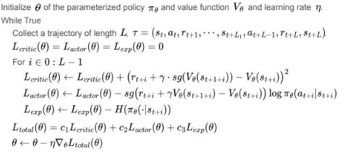
Advantage function

Slide 9
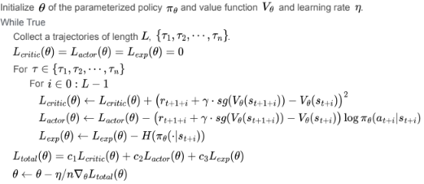
Advantage function
Multiple trajectories from paralleled environments

Slide 10
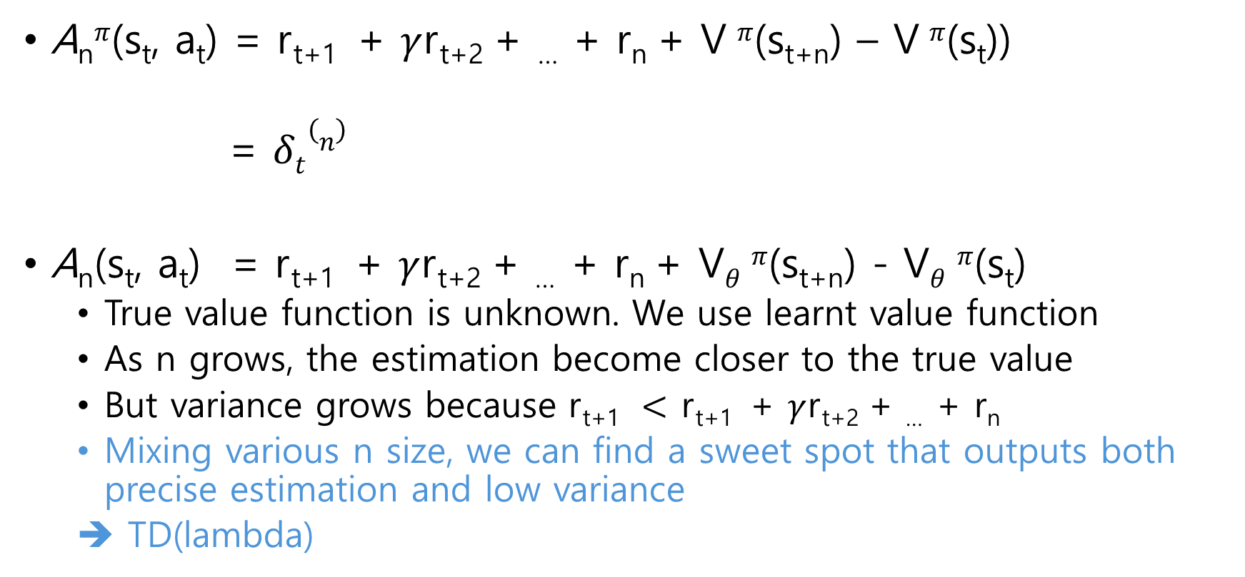
GAE
A_{n}$π$(s_{t}, a_{t}) = r_{t+1} + $γ$r_{t+2} + … + r_{n} + V $π$(s_{t+n}) – V $π$(s_{t}))
= $δt(n)$
A_{n}(s_{t}, a_{t}) = r_{t+1} + $γ$r_{t+2} + … + r_{n} + V$θ$ $π$(s_{t+n}) - V$θ$ $π$(s_{t})
True value function is unknown. We use learnt value function
As n grows, the estimation become closer to the true value
But variance grows because r_{t+1} $<$ r_{t+1} + $γ$r_{t+2} + … + r_{n}
Mixing various n size, we can find a sweet spot that outputs both precise estimation and low variance
➔ TD(lambda)
N-step TD target
N-step TD error

Slide 11
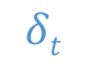
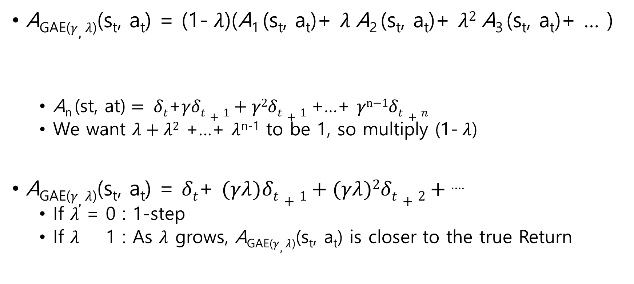
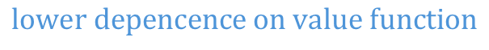
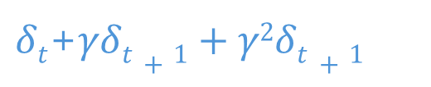
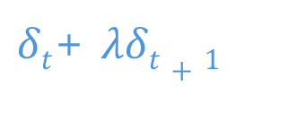
GAE
A_{GAE(}$γ,λ$₎(s_{t}, a_{t}) = (1- $λ$)(A₁ (s_{t}, a_{t})+ $λ$A₂ (s_{t}, a_{t})+ $λ2$A₃ (s_{t}, a_{t})+ … )
$\text{A}\text{n} \text{(}\text{st}\text{, }\text{at}\text{)}= δt$+$γδt+1+γ\text{2}δt+1$ +…+ $γ\text{n}\text{−1}δt+n$
We want $λ+λ2$ +…+ $λ$^{n-1} to be 1, so multiply (1- $λ$)
A_{GAE(}$γ,λ$₎(s_{t}, a_{t}) = $δt$+ $(γλ)δt+1+(γλ)\text{2}δt+2+$ ….
If $λ$ = 0 : 1-step
If $λ$ 1 : As $λ$ grows, A_{GAE(}$γ,λ$₎(s_{t}, a_{t}) is closer to the true Return
$$δt$$
$δt$+ $λδt+1$
$δt$+$γδt+1+γ\text{2}δt+1$
$$lower depencence on value function$$

Slide 12
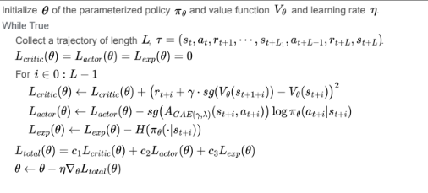
GAE

Slide 13
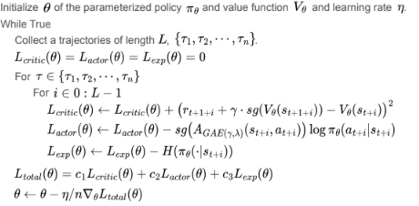
GAE

Slide 14
Monte-Carlo PG Off-policy PG Off-policy AC

Slide 15

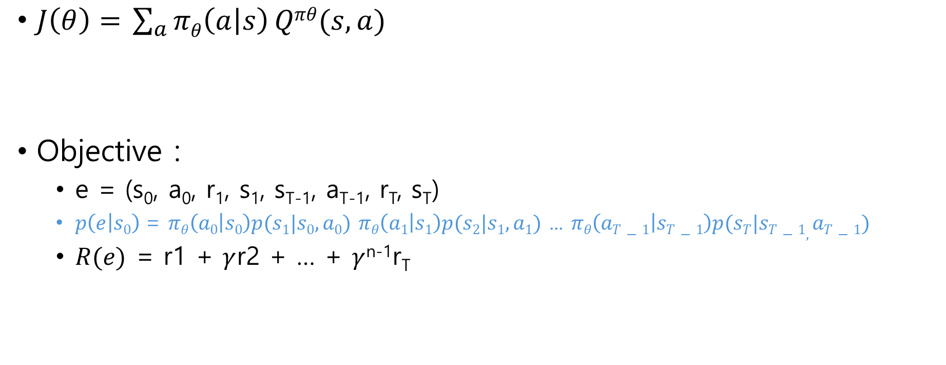
Monte-Carlo Policy Gradient
$J\left(θ\right)=$ $\sum_{a}{πθ\left(a | s\right)}Qπθ(s,a)$
Objective :
e = (s₀, a₀, r₁, s₁, s_{T-1}, a_{T-1}, r_{T}, s_{T})
$p\left(e | s0\right)$= $πθ\left(a0 | s0\right)p(s1|s0,a0)$ $πθ\left(a1 | s1\right)p(s2|s1,a1)$ ... $πθ\left(aT−1 | sT−1\right)p(sT|sT−1,aT−1)$
$R(e)$ = r1 + $γ$r2 + … + $γ$^{n-1}r_{T}
※ Off-policy$\left\{\begin{aligned}πb \text{: }\text{c}\text{ollects} d\text{ata} \\ πt \text{: }\text{l}\text{earns} t\text{arget} \text{policy} \end{aligned}\right.$
$J\left(θ|s0\right)=$ $\sum_{e}{pθ\left(e | s0\right)}R(e)$

Slide 16
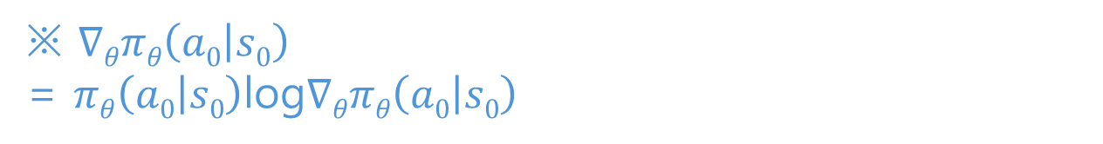
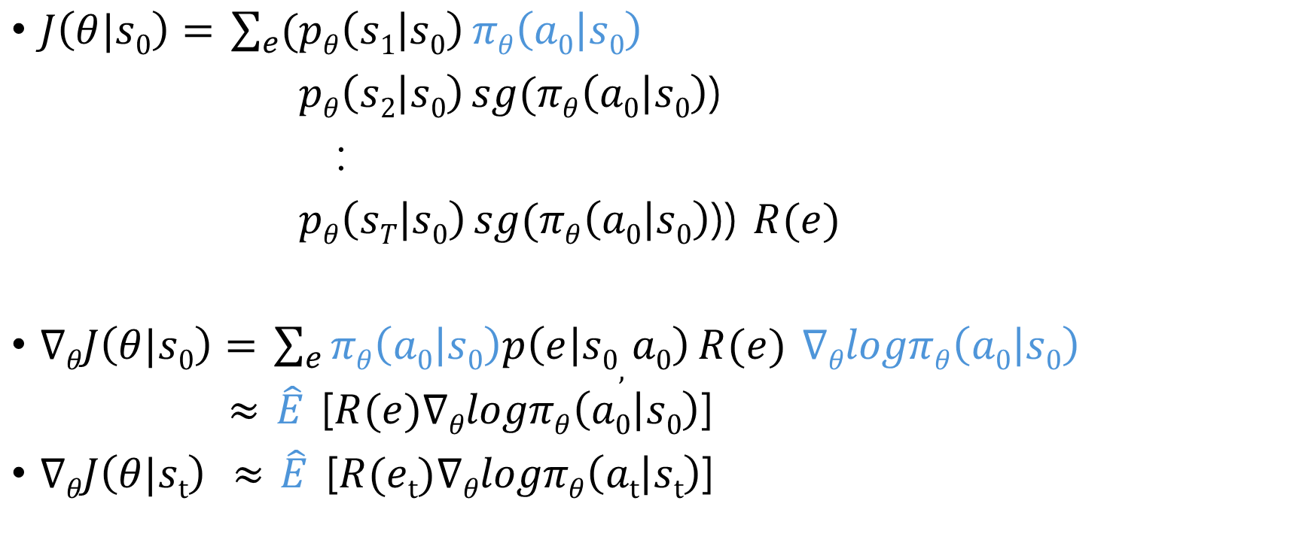
Monte-Carlo Policy Gradient
$J\left(θ|s0\right)=$ $\sum_{e}{(pθ\left(s1 | s0\right)}πθ\left(a0 | s0\right)$
$pθ\left(s2 | s0\right) sg(πθ\left(a0 | s0\right)$)
:
$pθ\left(sT | s0\right) sg(πθ\left(a0 | s0\right)$)) $R(e)$
$∇θJ\left(θ|s0\right)=$ $\sum_{e}{πθ\left(a0 | s0\right)p\left(e | s0, a0\right)}R(e)$ $∇θlogπθ\left(a0 | s0\right)$
$≈$ $\hat{E}$ [$R(e)∇θlogπθ\left(a0 | s0\right)$]
$∇θJ\left(θ|st\right)$ $≈$ $\hat{E}$ [$R(et)∇θlogπθ\left(at | st\right)$]
※ $∇θπθ\left(a0 | s0\right)$
= $πθ\left(a0 | s0\right)$log$∇θπθ\left(a0 | s0\right)$
stop gradient

Slide 17
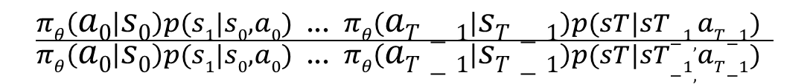
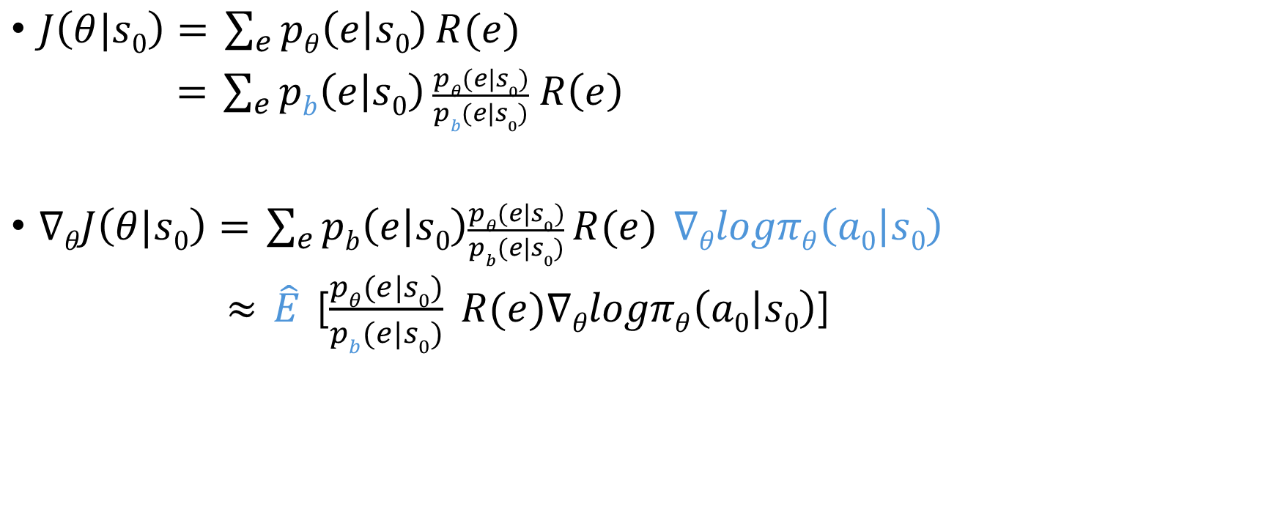
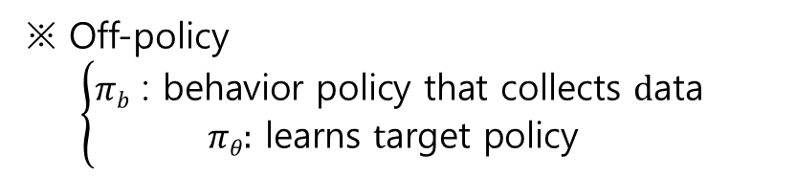
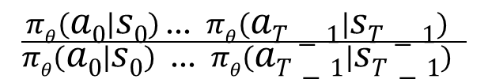
Off-policy Policy Gradient
※ Off-policy
$$\left\{\begin{aligned}πb \text{: }\text{behavior} \text{policy} \text{that} \text{collects} d\text{ata} \\ πθ\text{:} \text{l}\text{earns} t\text{arget} \text{policy} \end{aligned}\right.$$
$J\left(θ|s0\right)=$ $\sum_{e}{pθ\left(e | s0\right)}R(e)$
$=$ $\sum_{e}{pb\left(e | s0\right)}\frac{pθ(e|s0)}{pb(e|s0)} R\left(e\right)$
$∇θJ\left(θ|s0\right)=$ $\sum_{e}{pb\left(e | s0\right)\frac{pθ(e|s0)}{pb(e|s0)}}R(e)$ $∇θlogπθ\left(a0 | s0\right)$
$≈$ $\hat{E}$ [$\frac{pθ(e|s0)}{pb(e|s0)} R(e)∇θlogπθ\left(a0 | s0\right)$]
Importance sampling ratio
$$\frac{πθ\left(a0 | s0\right)p(s1|s0,a0)\text{ ...} πθ\left(aT−1 | sT−1\right)p(sT|sT−1,aT−1) }{πθ\left(a0 | s0\right)p(s1|s0,a0)\text{ ...} πθ\left(aT−1 | sT−1\right)p(sT|sT−1,aT−1) }$$
$$\frac{πθ\left(a0 | s0\right) \text{...} πθ\left(aT−1 | sT−1\right) }{πθ\left(a0 | s0\right)\text{ ...} πθ\left(aT−1 | sT−1\right) }$$
This value could be a very big!!
instable learning problem due to high variance.

Slide 18
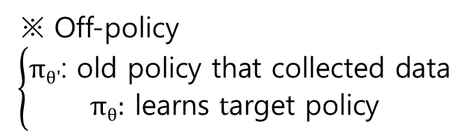
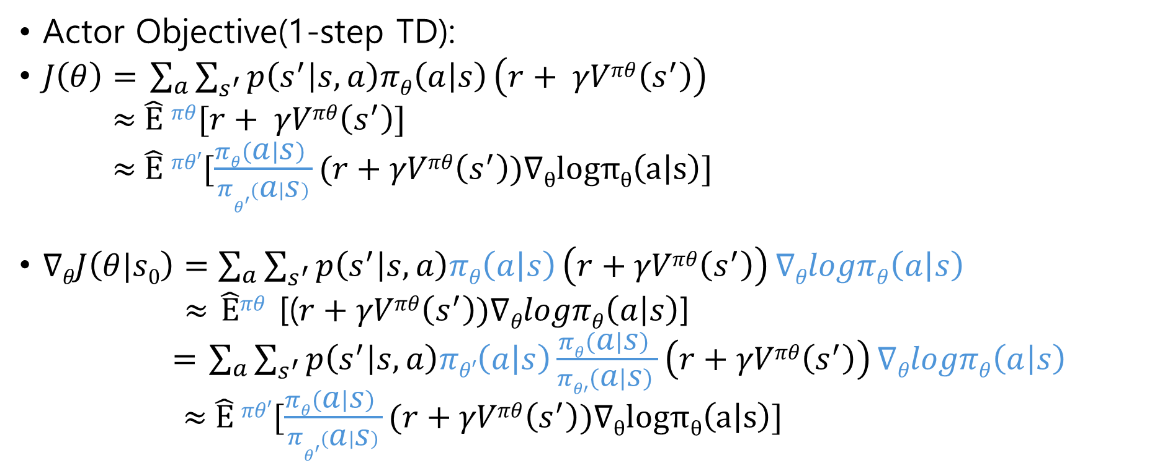
Off-policy Actor-Critic
※ Off-policy
$$\left\{\begin{aligned}πθ\text{′}\text{: }\text{old} \text{policy} \text{that} \text{collected} \text{data} \\ πθ\text{:} \text{l}\text{earns} t\text{arget} \text{policy} \end{aligned}\right.$$
Actor Objective(1-step TD):
$J\left(θ\right)=$ $\sum_{a}{\sum_{s^{′}}{p\left(s^{′} | s,a\right)πθ\left(a | s\right)}\left(r+ γVπθ\left(s^{′}\right)\right) }$
$≈$ $\hat{E}$ $πθ$[$r+ γVπθ\left(s^{′}\right)$]
$≈$ $\hat{E}$ $πθ′$[$\frac{πθ\left(a | s\right) }{πθ^{′\left(a | s\right)}}(r+γVπθ\left(s^{′}\right))∇θlogπθ\left(a | s\right)$]
$∇θJ\left(θ|s0\right)=\sum_{a}{\sum_{s^{′}}{p\left(s^{′} | s,a\right)πθ\left(a | s\right)}\left(r+γVπθ\left(s^{′}\right)\right)}∇θlogπθ\left(a | s\right)$
$≈$ $\hat{E}πθ$ [($r+γVπθ\left(s^{′}\right))∇θlogπθ\left(a | s\right)$]
$=$ $\sum_{a}{\sum_{s^{′}}{p\left(s^{′} | s,a\right)πθ′\left(a | s\right)}\frac{πθ\left(a | s\right) }{πθ′\left(a | s\right) }\left(r+γVπθ\left(s^{′}\right)\right)}∇θlogπθ\left(a | s\right)$
$≈$ $\hat{E}$ $πθ′$[$\frac{πθ\left(a | s\right) }{πθ^{′\left(a | s\right)}}(r+γVπθ\left(s^{′}\right))∇θlogπθ\left(a | s\right)$]
This value could be a very big!!
instable learning problem due to high variance.

Slide 19
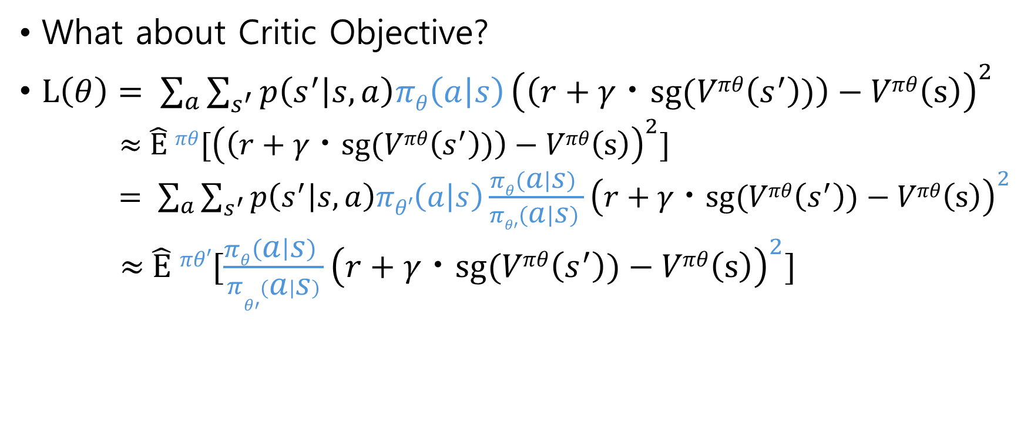
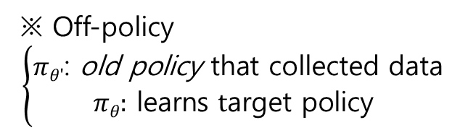
Off-policy Actor-Critic
※ Off-policy
$$\left\{\begin{aligned}πθ\text{′}\text{: }\text{old} \text{policy} \text{that} \text{collected} \text{data} \\ πθ\text{:} \text{l}\text{earns} t\text{arget} \text{policy} \end{aligned}\right.$$
What about Critic Objective?
$L\left(θ\right)= \sum_{a}{\sum_{s^{′}}{p\left(s^{′} | s,a\right)πθ\left(a | s\right)}{\left(\left(r+γㆍsg(Vπθ\left(s^{′}\right))\right)−Vπθ\left(s\right)\right)}^{2}}$
$≈$ $\hat{E}$ $πθ$[${\left(\left(r+γㆍsg(Vπθ\left(s^{′}\right))\right)−Vπθ\left(s\right)\right)}^{2}$]
$= \sum_{a}{\sum_{s^{′}}{p\left(s^{′} | s,a\right)πθ′\left(a | s\right)}\frac{πθ\left(a | s\right) }{πθ′\left(a | s\right) }{\left(r+γㆍsg(Vπθ\left(s^{′}\right))−Vπθ\left(s\right)\right)}^{2}}$
$≈$ $\hat{E}$ $πθ′$[$\frac{πθ\left(a | s\right) }{π{θ′}^{\left(a | s\right)}}{\left(r+γㆍsg(Vπθ\left(s^{′}\right))−Vπθ\left(s\right)\right)}^{2}$]
This value could be a very big!!
instable learning problem due to high variance.

Slide 20
Proximal Policy Optimization(PPO)

Slide 21
Overview
PPO problem statement:
Q-learning is tricky,
vanilla PG is low in sample efficiency and unstable in learning
TRPO is stable but rather complex and unable to share parameters btw. value and policy
PPO is On-policy learning alg., but uses Off-policy data and update multiple times per sample (high sample efficiency)

Slide 22
Overview
PPO updates the policy conservatively
It stops the policy change too fast or dramatically
The surrogate objective prevent the new policy from changing too far from the old policy
Importance Sampling ratio could be a very big!!
(instable learning problem due to high variance)
Updating multiple times per sample worsen learning instabilities
An actor learning w/o well learnt critic adds instability
(sub-optima convergence)

Slide 23
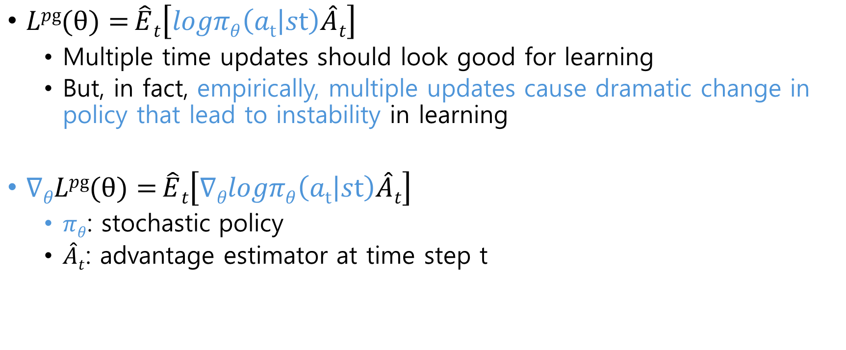
Method
$Lpg(θ)={\hat{E}t\left[logπθ\left(at | st\right)\hat{A}t\right]}$
Multiple time updates should look good for learning
But, in fact, empirically, multiple updates cause dramatic change in policy that lead to instability in learning
$∇θLpg(θ)={\hat{E}t\left[∇θlogπθ\left(at | st\right)\hat{A}t\right]}$
$πθ$: stochastic policy
$\hat{A}t$: advantage estimator at time step t

Slide 24
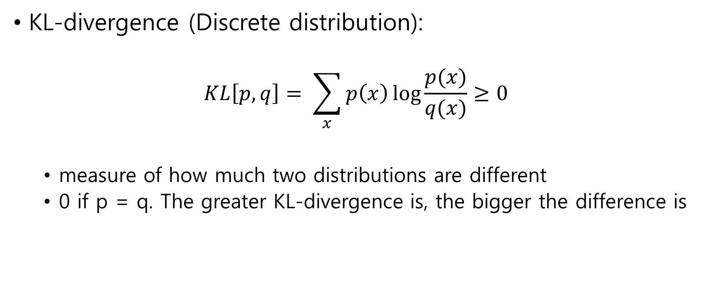
Method
KL-divergence (Discrete distribution):
$$KL\left[p, q\right]= \sum_{x}{p\left(x\right)\log{\frac{p(x)}{q(x)}≥0}}$$
measure of how much two distributions are different
0 if p = q. The greater KL-divergence is, the bigger the difference is
Want to increase value accuracy as much as possible while updating the policy very conservatively

Slide 25
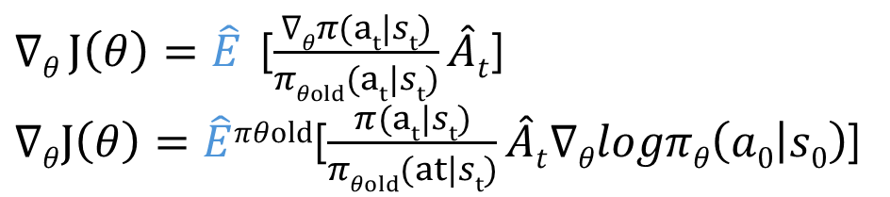
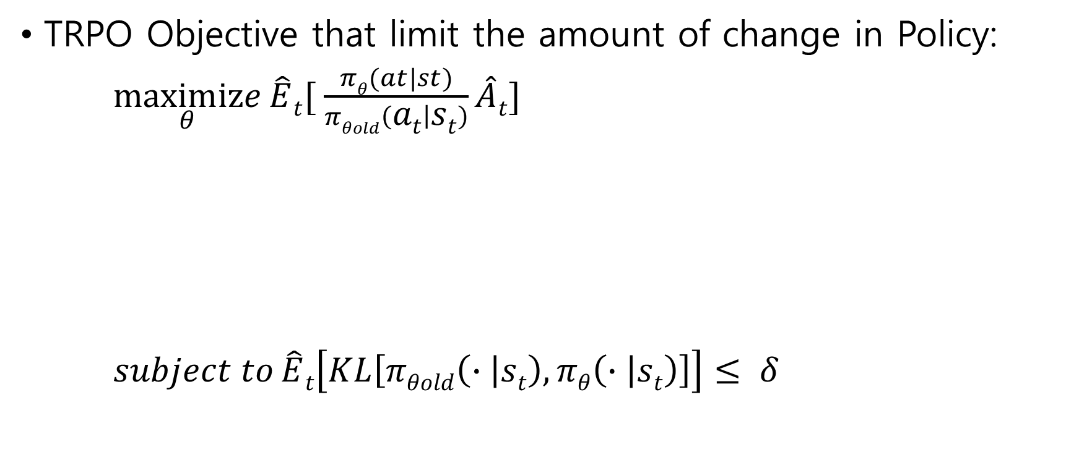
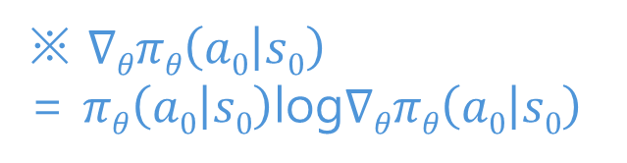
Method
TRPO Objective that limit the amount of change in Policy:
$\underset{θ}{maximize}{\hat{E}t[ \frac{πθ(at|st)}{πθold\left(at | st\right)}\hat{A}t]}$
$subject to{\hat{E}t\left[KL\left[πθold\left(∙ | st\right),πθ\left(∙ | st\right)\right]\right]≤ δ}$
※ $∇θπθ\left(a0 | s0\right)$
= $πθ\left(a0 | s0\right)$log$∇θπθ\left(a0 | s0\right)$
$∇θ J\left(θ\right)=\hat{E}$ [$\frac{∇θπ(at|st)}{πθold(at|st)}\hat{A}t$]
$∇θJ\left(θ\right)=\hat{E}πθold$[$\frac{π(at|st)}{πθold(at|st)}\hat{A}t∇θlogπθ\left(a0 | s0\right)$]
Equal to off-policy PG
Allow the new policy to change by $δ$ from the old policy

Slide 26
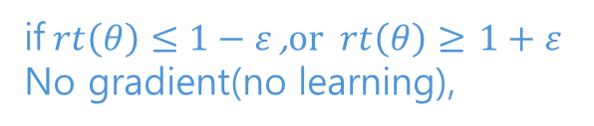
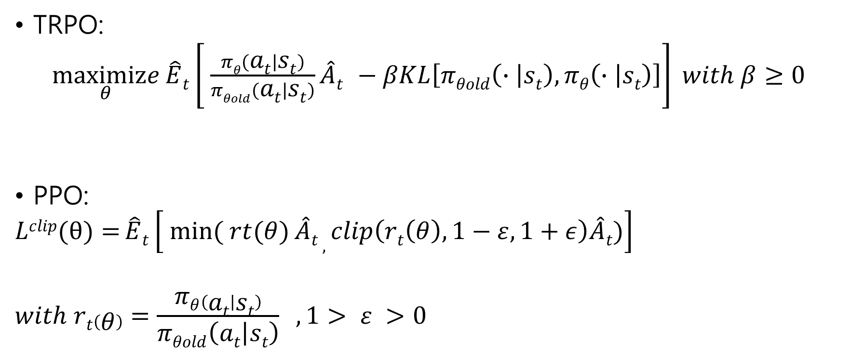


Objective
TRPO:
$\underset{θ}{maximize}{\hat{E}t\left[ \frac{πθ\left(at | st\right)}{πθold\left(at | st\right)}\hat{A}t −βKL\left[πθold\left(∙ | st\right),πθ\left(∙ | st\right)\right]\right]} with β≥0$
PPO:
$$Lclip(θ)={\hat{E}t\left[ \min_{}{( rt(θ)}\hat{A}t , clip\left(rt\left(θ\right), 1−ε, 1+ε\right)\hat{A}t)\right]}$$
$$with rt\left(θ\right)=\frac{πθ\left(at | st\right)}{πθold\left(at | st\right)} ,1> ε >0$$
Stop a new policy become too different from the behavior policy $πθold$
Setting $β$ is difficult
if$rt\left(θ\right)≤1−ε$ ,$or rt\left(θ\right)≥$ $1+ε$
No gradient(no learning),

Slide 27
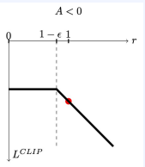
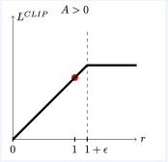
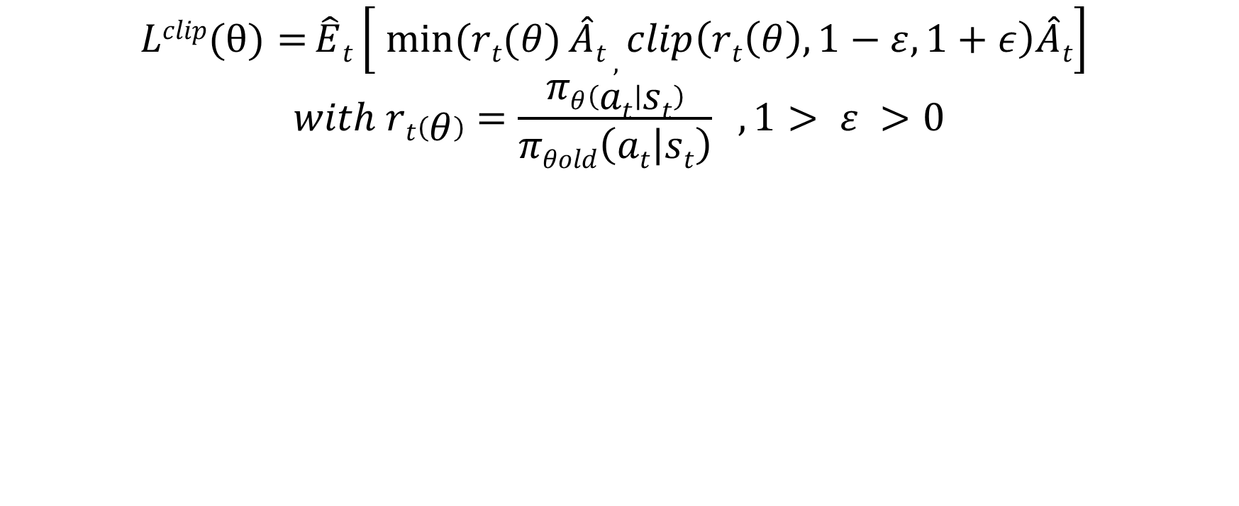
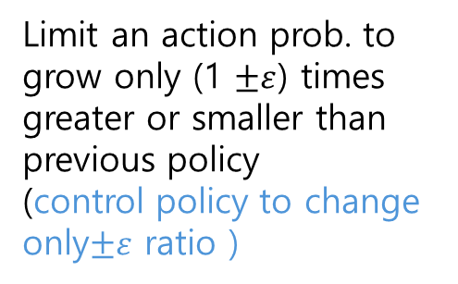
Objective
$$Lclip(θ)={\hat{E}t\left[ \min_{}{(rt(θ)}\hat{A}t , clip\left(rt\left(θ\right), 1−ε, 1+ε\right)\hat{A}t\right]}$$
$$with rt\left(θ\right)=\frac{πθ\left(at | st\right)}{πθold\left(at | st\right)} ,1> ε >0$$
Loss does not grow
= No gradient
Limit an action prob. to grow only (1 $±ε$) times greater or smaller than previous policy
(control policy to change only$±ε$ ratio )

Slide 28
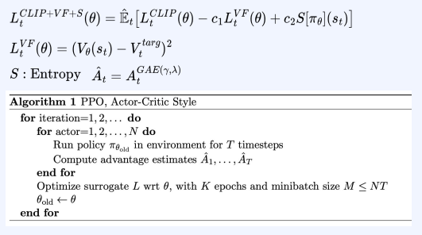
Objective
Maximize constraint off-policy gradient
Minimize loss
bonus
Parallel learning

Slide 29
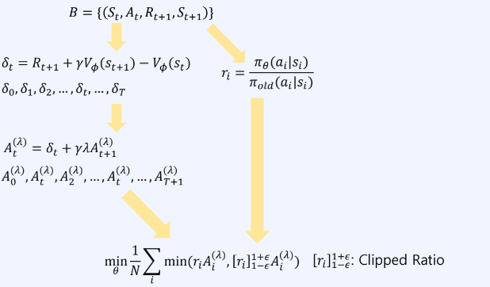
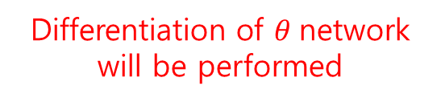
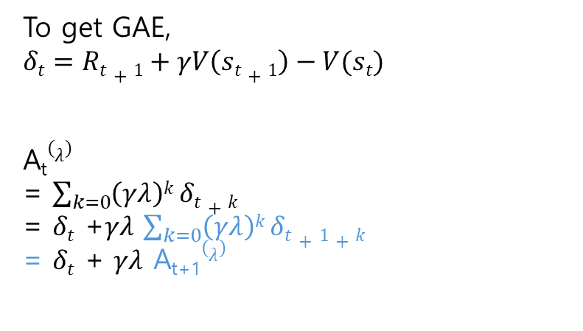
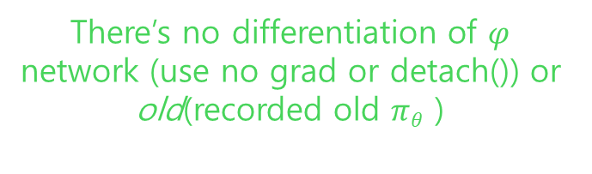
Policy Loss
There’s no differentiation of $φ$ network (use no grad or detach()) or old(recorded old $πθ$ )
To get GAE,
$$δt=Rt+1+γV\left(st+1\right)−V(st)$$
A_{t}$(λ)$
= $\sum_{k=0}{\left(γλ\right)k}δt+k$
= $δt$ +$γλ$ $\sum_{k=0}{\left(γλ\right)k}δt+1+k$
= $δt$ + $γλ$ A_{t+1}$(λ)$
Differentiation of $θ$network will be performed

Slide 30
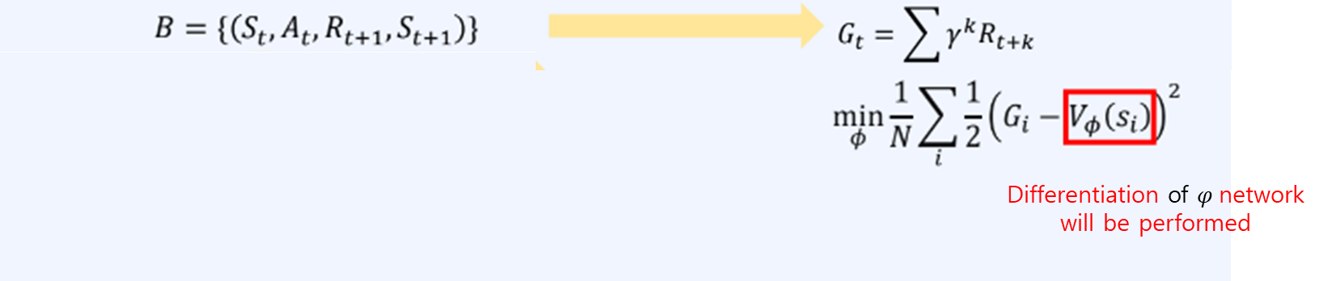
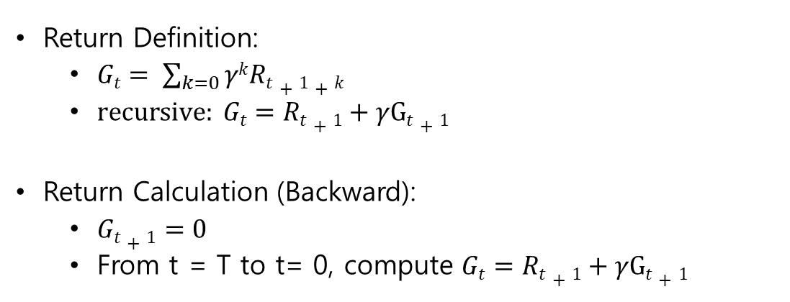
Value Loss
Return Definition:
$Gt= \sum_{k=0}{γkRt+1+k}$
$recursive: Gt=Rt+1+γGt+1$
Return Calculation (Backward):
$Gt+1=0$
From t = T to t= 0, compute $Gt=Rt+1+γGt+1$

Slide 31
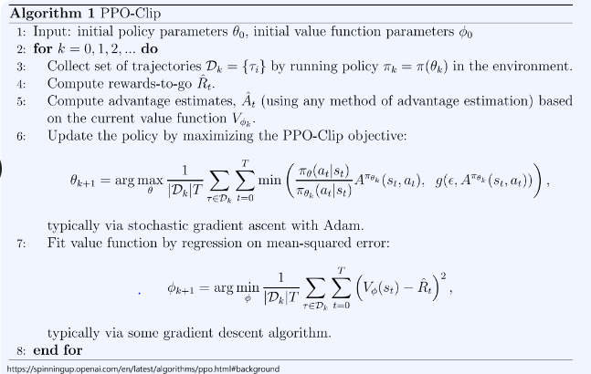
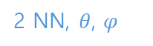
Pseudo Code:PPO
2 NN, $θ$, $φ$
The same policy but old
Note fitting V requires no target policy (On-policy learning)

Slide 32
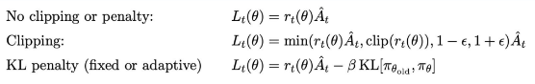
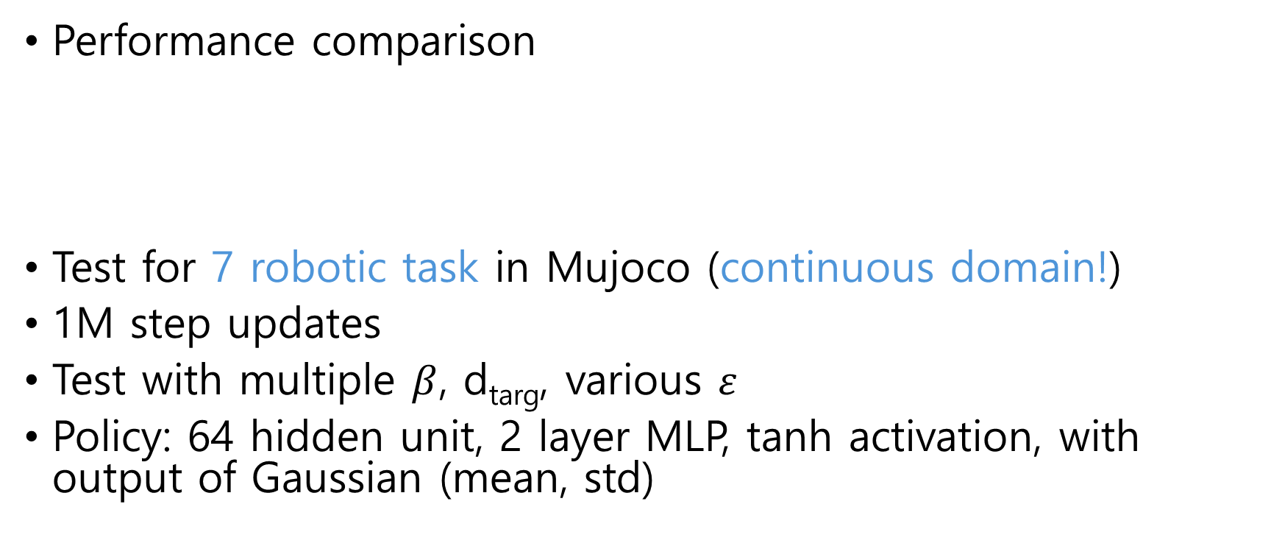
Results
Performance comparison
Test for 7 robotic task in Mujoco (continuous domain!)
1M step updates
Test with multiple $β$, d_{targ}, various $ε$
Policy: 64 hidden unit, 2 layer MLP, tanh activation, with output of Gaussian (mean, std)

Slide 33
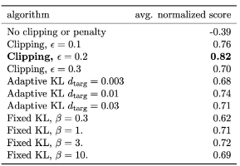
Results
No parameter sharing, no entropy bonus
3 random seed
avg. score for the last 100 before the end
Normalization 0~1
No clipping & KL penalty is -0.39
Clipping score is 0.82

Slide 34


Results
PPO shows sample efficiency and stable learning
$ε$ = 0.2

Slide 35

Results
High-dimensional continuous control test of PPO: 3D humanoid
RoboschoolHumannoid: moving forward
RoboschoolHumanoidFlagrun: moving forward with moving target every 200 timestep
RoboschoolHumanoidFlagranHarder: throw a cube to the robot tumble and stand-up again

Slide 36


Results
Learning in Atari domain:
The number of games out of 48

Slide 37
Code Ex.1
configuration.py
utils.py
agent.py
train.py
eval.py

Slide 38

Code Ex.1
‘Cartpole’ Env.: move a cart (black) such that it balances a pendulum (brown) without moving too far from the center.
State:
The agent observes current position and velocity of the cart, as well as angle and velocity of the pole
cart position, cart velocity, pole angle, pole angular velocity
Action:
0: push the cart left
1: push the cart right
Reward:+1 for every step

Slide 39

configuration.py
Critic loss constant
actor loss constant
Exploration loss constant (entropy loss constant)
Parallel environment to collect trajectories
Length of a trajectory
Learning from a batch that contains 64 trajectories

Slide 40

train.py
Vector environments
One agent

Slide 41

train.py
Parallelized environments shares config.train_env_steps load
One agent plays in multiple environments
Trajectory rollout until seq_length
pi is behavior policy
a is an action sampled
from pi
Put the behavior policy into a trajectory in batch

Slide 42

agent.py
GAE(Generalized advantage function)

Slide 43


agent.py
batch size is 64 trajectories
Each trajectory has seq. length 16

Slide 44

agent.py
A trajectory dictionary
We’ll record the behavior policy every time step the agent act.
Add a sample to the batch
When a seq. is full
Create a new seq.
Add the seq. to the batch

Slide 45

agent.py
Action sample using pi distribution

Slide 46

agent.py
Train repeating k epoch with minibatch_size
To insert into NN.
Mask for updating policy

Slide 47






agent.py
[P(a1),p(a2)], V(s_{t})
V(s_{t+1})
$\hat{A}t$ is GAE that uses N-step TD target
$V$alue target
$Critic loss(LVF$)
$$rt\left(θ\right)=\frac{πθ\left(at | st\right)}{πθold\left(at | st\right)}$$
$$Actor loss Lclip(θ)={\hat{E}t\left[ \min_{}{( rt(θ)}\hat{A}t , clip\left(rt\left(θ\right), 1−ε, 1+ε\right)\hat{A}t)\right]}$$

Slide 48





agent.py
$Entropy$ $bonus$
$Add all$loss
$$and make actor−critic loss$$
$$Gradient descent$$
$$Throw away$$
$$the batch$$

Slide 49

Code Ex.2
Upload ‘proximal_policy_optimizatin.ipynb’ file onto Colab
The notebook includes ‘Mujoco’ environment, ‘Half Cheetah’
State(17):
(body parts) position,
(roter, axis) angle or velocity
Action(6):
Torque on 6 roters (-1~1)
Reward:
Forward_reward: moving-forward reward
ctrl_cost: penalty in taking too large action

Slide 50

Continuous Action
PPO uses Gaussian policy
as stochastic policy

Slide 51


Collecting episodes
Initial sampling
$S0 \sim d(∙)$
Action sampling from Policy
$μt= πθ(s)$
$ε\sim N\left(o, I\right)$ :Noisiness for exploration
$at= μ+ σεt$ :Reparameterization trick
Simulation
$st+1, rt+1, dt+1$= env.step($at$)
Next_state
Reward
Done, terminal information
learnt std.

